Slide 1
WorkshopPLUS Power Platform for Administrators
On-Premise Data Gateways
Notes:
Workshop Version: 2.6

Slide 2
Conditions and terms of use
© Microsoft Corporation. All rights reserved.
You may use these training materials solely for your personal internal reference and non-commercial purposes. You may not distribute, transmit, resell or otherwise make these training materials available to any other person or party without express permission from Microsoft Corporation. URL’s or other internet website references in the training materials may change without notice. Unless otherwise noted, any companies, organizations, domain names, e-mail addresses, people, places and events depicted in the training materials are for illustration only and are fictitious. No real association is intended or inferred. THESE TRAINING MATERIALS ARE PROVIDED “AS IS”; MICROSOFT MAKES NO WARRANTIES, EXPRESS OR IMPLIED IN THESE TRAINING MATERIALS

Slide 3

Objectives
After completing this Learning, you will be able to:
 | 1 | Understand…. What on-premises data gateways are How on-premises data gateways work
 | 2 | Understand…. How to install and configure the gateway
 | 3 | Understand…. How to manage gateways

Slide 4
Understand On-Premises Data Gateway

Slide 5
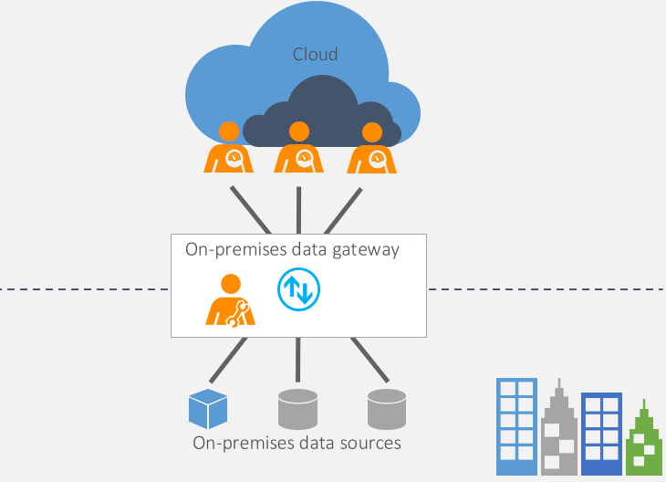
What is On-Premise Data Gateway?
Acts as a bridge to provide quick and secure data transfer between on-premises data and several Microsoft cloud services
Includes Power BI, Power Apps, Power Automate, Azure Analysis Services, and Azure Logic Apps
Organizations can keep databases and other data sources on their on-premises networks, yet securely use that on-premises data in cloud services.
Users in your organization can access on-premises data to which they already have access authorization.
Administrators will need to install and configure Gateway before users are able to connect on-premise data sources.
Microsoft Confidential

Slide 6
Three Types of Data Gateway
On-premises data gateway (standard)
Allows multiple users to connect to multiple on-premises data sources
Support all available gateway services like Power Apps and Power Automate
Well-suited to complex scenarios in which multiple people access multiple data sources
On-premises data gateway (personal mode)
Allows one user to connect to sources and can’t be shared with others.
Can be used only with Power BI
Well-suited to scenarios in which you’re the only person who creates reports, and you don't need to share any data sources with others
Virtual network data gateway
Allows multiple users to connect to multiple data sources that are secured by virtual networks
No installation is required because it's a Microsoft managed service.
Well-suited to complex scenarios in which multiple people access multiple data sources
Microsoft Confidential

Slide 7
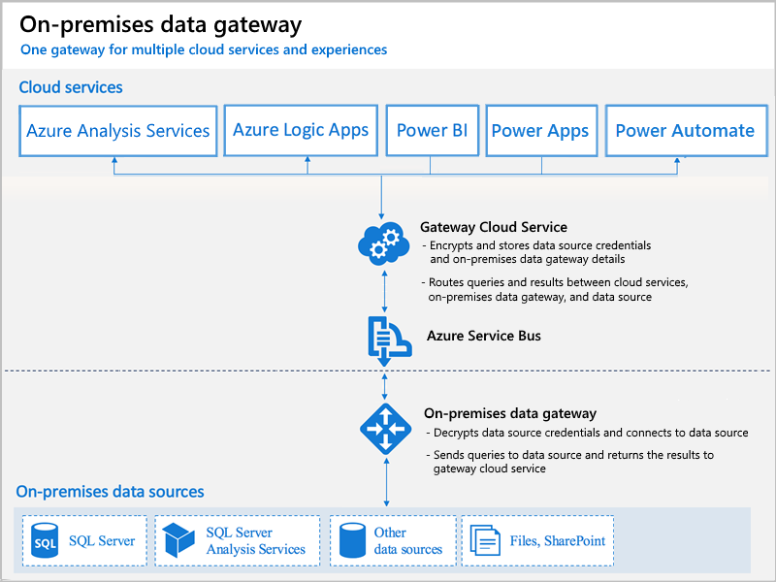
How the gateway works?
The cloud service creates a query and the encrypted credentials for the on-premises data source.
The query and credentials are sent to the gateway queue for processing.
The gateway cloud service analyzes the query and pushes the request to Azure Service Bus Messaging.
Azure Service Bus sends the pending requests to the gateway. Both the gateway and Power BI service are implemented to only accept TLS 1.2 traffic.
The gateway gets the query, decrypts the credentials, and connects to one or more data sources with those credentials.
The gateway sends the query to the data source to be run.
The results are sent from the data source back to the gateway and then to the cloud service.
Microsoft Confidential
Notes:
NOTE! In step 7, queries like Power BI refreshes and Azure Analysis Services refreshes can return large amounts of data.
For such queries, data is temporarily stored on the gateway machine.
This data storage continues until all data is received from the data source.
The data is then sent back to the cloud service.
This process is called spooling.
We recommend you use a solid-state drive (SSD) as the spooling storage.

Slide 8
Data Gateway Installation Facts

Slide 9
Install an on-premises data gateway
Gateway is software that you install in an on-premises network.
The gateway facilitates access to data in that network.
As we explain in the overview, you can install a gateway either in personal mode, which applies to Power BI only, or in standard mode.
We recommend standard mode as in that mode you can add a gateway to a cluster of gateways, which we recommend for high availability and performance.
Microsoft Confidential

Slide 10
Install an on-premises data gateway
Minimum requirements
.NET Framework 4.6 (Gateway release August 2019 and earlier)
.NET Framework 4.7.2 (Gateway release September 2019 and later)
A 64-bit version of Windows 8 or a 64-bit version of Windows Server 2012 R2 with current TLS 1.2 and cipher suites
4 GB disk space for performance monitoring logs (in default configuration)
Recommended hardware
An 8-core CPU
8 GB of memory
A 64-bit version of Windows Server 2012 R2 or later
Solid-state drive (SSD) storage for spooling
Microsoft Confidential

Slide 11
General Considerations for installation
Server Core and Domain Controller installation not supported
The user installing the gateway will be the admin of the gateway.
If you're planning to use Windows authentication, the gateway computer must be member of the same Active Directory environment as the data sources.
Don't install a gateway on a client machine, like a laptop, that might be turned off, asleep, or disconnected from the internet.
To optimize performance, it is not recommended to use WLAN connection, and computer should also be dedicated for Data Gateway not having other applications running on the same machine.
You can install up to two gateways on a single computer: one running in personal mode and the other running in standard mode. You can't have more than one gateway running in the same mode on the same computer.
Microsoft Confidential

Slide 12

Demonstration
Install On-premise Data Gateway
In LAB environment install data gateway to ContosoGateway server
Download latest version (explain that we release new version every month)
Install gateway using MOD admin creds
OPTIONAL – skip slides of the next section by demoing gateway features
Notes:
Consider demoing the following:
In LAB environment install data gateway to ContosoGateway server
Download latest version (explain that we release new version every month)
Install gateway using MOD admin creds
OPTIONAL – skip slides of the next section by demoing gateway features
##########

Slide 13
Data Gateway App Features
Notes:
NOTE! YOU CAN ALSO GO THROUGH THESE IN YOUR DEMO AFTER YOU HAVE INSTALLED THE GATEWAY

Slide 14
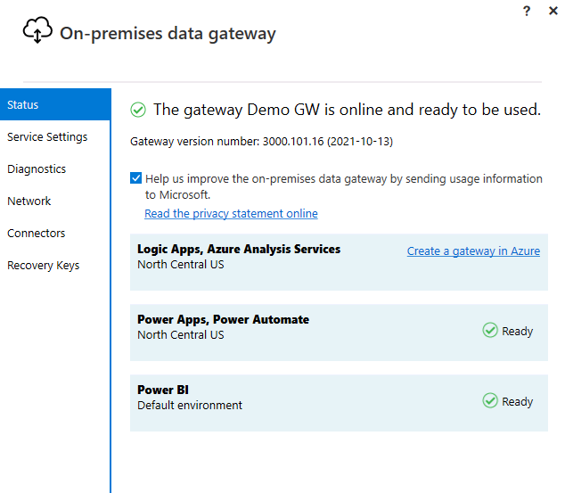
Data Gateway App Features
Status
Gateway status (online/offline)
Version number of the gateway
List of any apps currently associated with the gateway
Microsoft Confidential

Slide 15
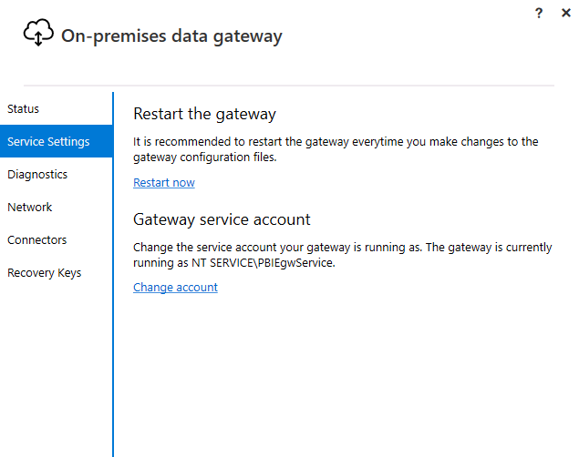
Data Gateway App Features
Service Settings
Provides a way of restarting the gateway whenever a restart is needed
Gateway service account
By default, configured to use NT SERVICE\PBIEgwService for the Windows service sign-in credential
Possibility to change gateway service account to use Active Directory user account or managed service account
Microsoft Confidential

Slide 16
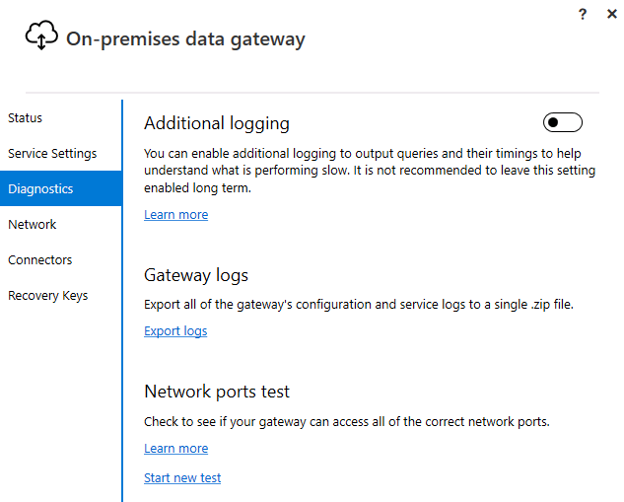
Data Gateway App Features
Diagnostics
Additional logging
Provides additional verbose information in the log file, which includes duration information. This information can be useful in figuring out why some responses through the gateway are slow
Enabling this feature could increase the log size significantly depending on gateway usage. So, we recommend that you don't leave this setting enabled long term.
Gateway logs
Provides a copy of all of the gateway logs in a single file in .zip format
Network ports test
Checks if the gateway has access to all required ports.
Microsoft Confidential

Slide 17
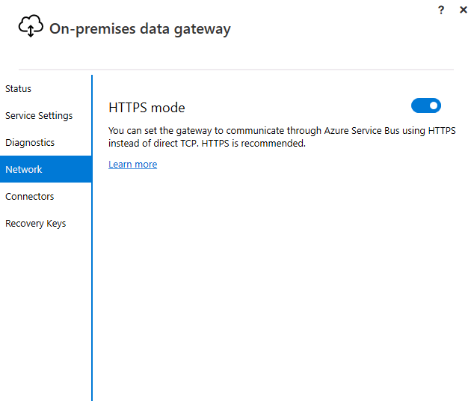
Data Gateway App Features
Network
HTTPS mode
Forces the gateway to communicate with Azure Service Bus by using HTTPS instead of TCP when turned on.
Microsoft Confidential

Slide 18
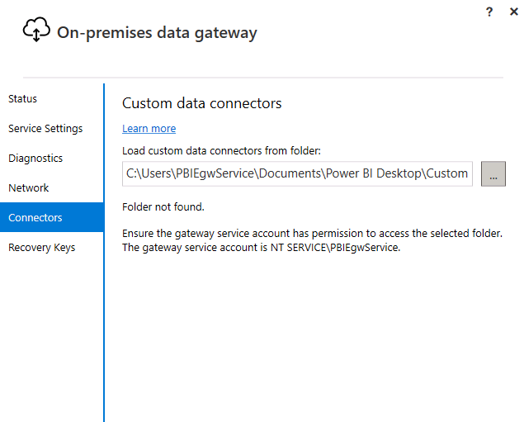
Data Gateway App Features
Custom Data Connectors
Custom data connectors
You can connect to and access data from Power BI by using custom data connectors that you develop.
Microsoft Confidential

Slide 19
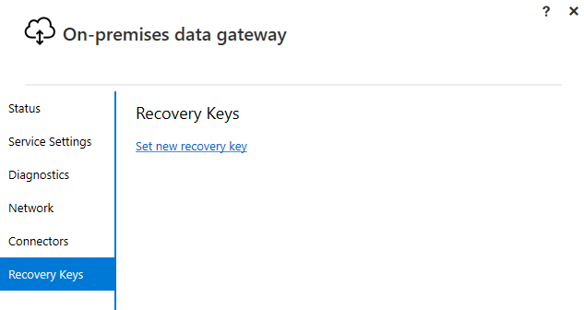
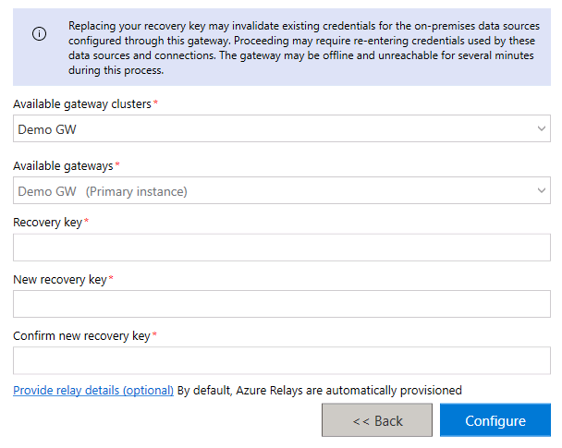
Data Gateway App Features
Recovery Keys
Changes the recovery key you specified when installing the on-premises data gateway
This feature does not appear until you have signed in.
Not available in the on-premises data gateway (personal mode)
Microsoft Confidential

Slide 20
Managing Data Gateways
Notes:
NOTE! YOU CAN ALSO GO THROUGH THESE IN YOUR DEMO AFTER YOU HAVE INSTALLED THE GATEWAY

Slide 21
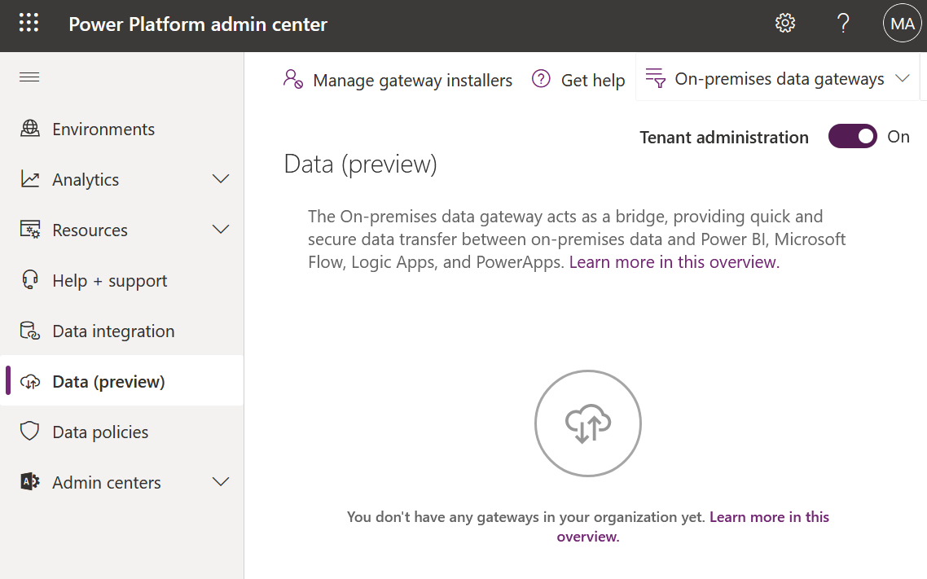
Manage Data Gateways in Power Platform Admin Center
Users having Global, Power Platform or Power BI Administrator role, or are Gateway administrators have access to data gateway management on the Power Platform admin center. However, there might be differences in the features available and the operations that can be performed by each of these roles.
Global, Power Platform, and Power BI Administrators can use the Tenant administration setting to control the list of gateways exposed.
Microsoft Confidential

Slide 22
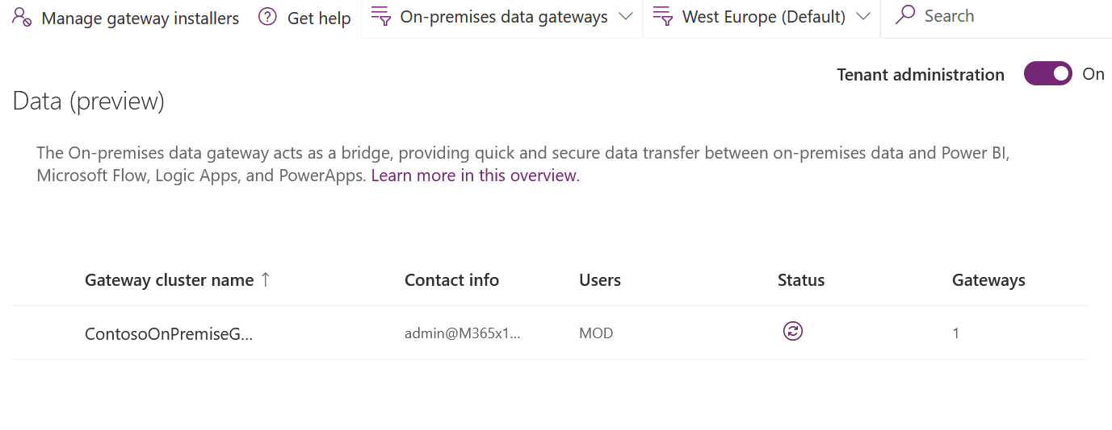
Manage Data Gateways in Power Platform Admin Center
All data page lists with on-premises data gateway clusters installed contains following information about gateway clusters:
Name of the gateway cluster
Admin contact information for the gateway cluster
The list of gateway users
See whether the gateway connection is online or offline
Number of gateway members in the gateway cluster
Microsoft Confidential

Slide 23
Manage Data Gateway Users
Every installed Data Gateway has a default admin user account which is the account that created it and who can grant certain permissions to other users to use this data gateway.
For personal gateways, this would show the owner of the personal gateway and cannot be changed due to the security scope of personal gateways.
For Data Gateway in standard mode, users can be added in any of these three categories (explained in more detail in next slide):
Connection Creator
Connection Creator with resharing
Admin
Microsoft Confidential

Slide 24
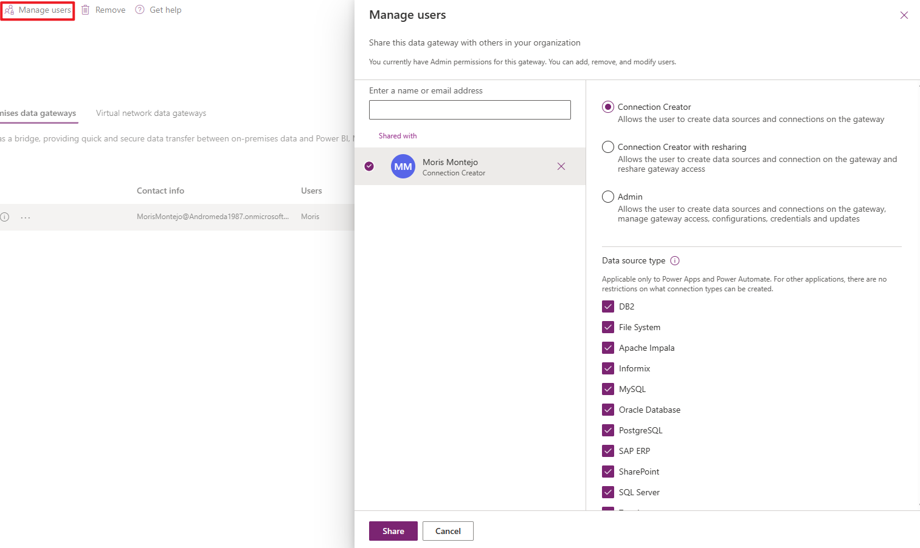
Manage Data Gateway Users
Connection Creator - Can create connections on the gateway to create for Apps and Flows but cannot share the gateway
Applies only to Power Apps and Power Automate
Connection Creator with resharing – Same as Connection Creator but can also share the gateway for others to use
Admin - Can manage gateway users, configuration, associated data sources, and connections
NOTE:
Connection Creator and Connection Creator with resharing do not apply to custom connectors in Power Apps and Power Automate.
While sharing gateways for Connection Creators and Connection creators with resharing permission levels, you can restrict the data source type that the user can connect over the gateway.
At least one data source type should be selected for the user to be successfully added.

Slide 25
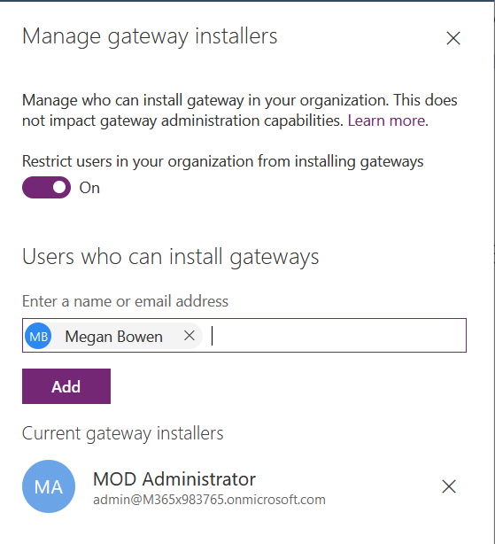
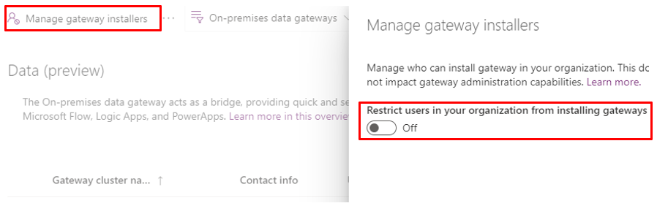
Manage gateway installers
Global, Power Platform, and Power BI Administrators can manage who can install the on-premises data gateway in your enterprise.
This operation isn't available for gateway admins.
This feature does not apply to personal data gateways.
By default, data gateway installation is enabled for all users unless you restrict users in your organization from installing gateways.
In admin center, you can enable Restrict Users in your organization from installing gateways, then add only allowed users to do so.
Microsoft Confidential

Slide 26
High-availability clusters for data gateway
Gateway high-availability clusters helps to ensure that your organization can access on-premises data resources from supported cloud services.
Gateway admins use such clusters to avoid single points of failure when accessing on-premises data resources.
The gateway cloud service always uses the primary gateway in a cluster unless that gateway isn't available, in that case, service switches to the next available gateway in the cluster.
After you create a cluster of two or more gateways, all gateway management operations like adding data sources and granting permissions apply to every gateway in the cluster.
Make sure the gateway members in a cluster are running the same gateway version, as different versions could cause unexpected failures based on supported functionality.
Microsoft Confidential

Slide 27
Communication settings for Data Gateway
Relies on Azure Service Bus for cloud connectivity.
Correspondingly establishes outbound connections to its associated Azure region.
If you registered for either a Power BI tenant or an Office 365 tenant, your Azure region defaults to the region of that service. Otherwise, your Azure region might be the one closest to you.
If a firewall blocks outbound connections, configure the firewall to allow outbound connections from the gateway to its associated Azure region.
The gateway communicates on the following outbound ports: TCP 443, 5671, 5672, and from 9350 through 9354.
The gateway does not require inbound ports.
The gateway communicates with Service Bus by using an IP address along with a fully qualified domain name (FQDN). If you force the gateway to communicate via HTTPS, it will strictly use FQDNs only and won't communicate by using IP addresses.

Slide 28
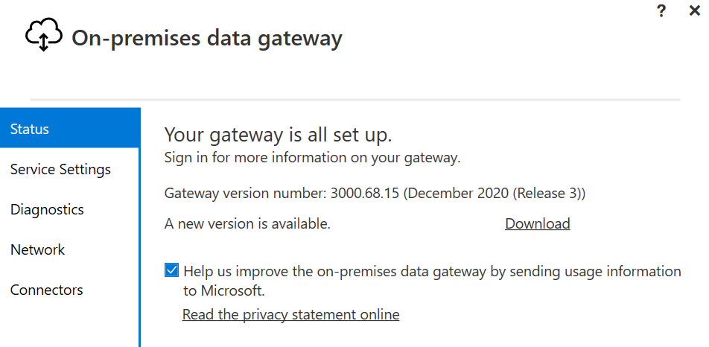
Update an on-premises data gateway
We release an update every month, and each of these updates includes new features along with the latest Mashup Engine.
If you're running a gateway cluster, we recommend that you update all nodes in the cluster at the same time.
Download the latest standard mode gateway or personal mode gateway and run the installation program.
You can check your current version from the Gateway Status screen
Note: Currently, Microsoft actively supports only the last six releases of the on-premises data gateway.
Microsoft Confidential

Slide 29
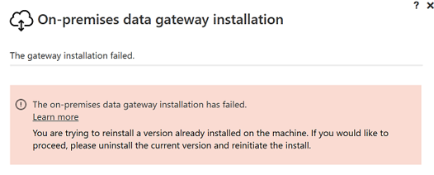
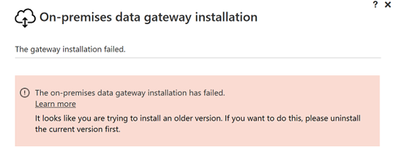
Update an on-premises data gateway
Download the latest gateway and run the installation program.
If the version you're trying to install isn't newer than the version already installed, you'll receive one of the following error messages.
Microsoft Confidential

Slide 30
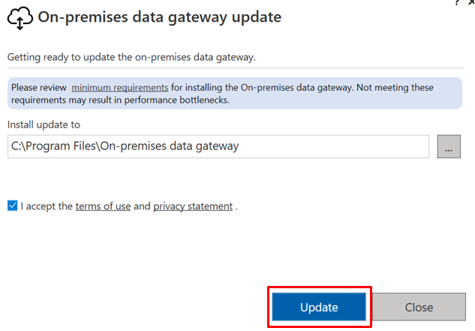
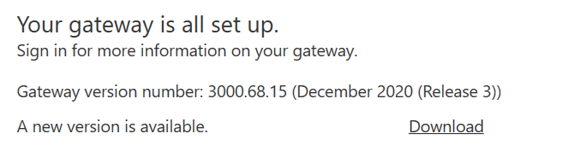
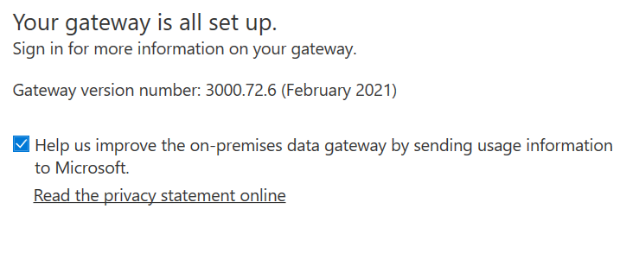
Update an on-premises data gateway
If you install a newer version, you'll be prompted to update.
After the installation finishes, see a new updated version of information from the Status screen of the Gateway.
Microsoft Confidential

Slide 31
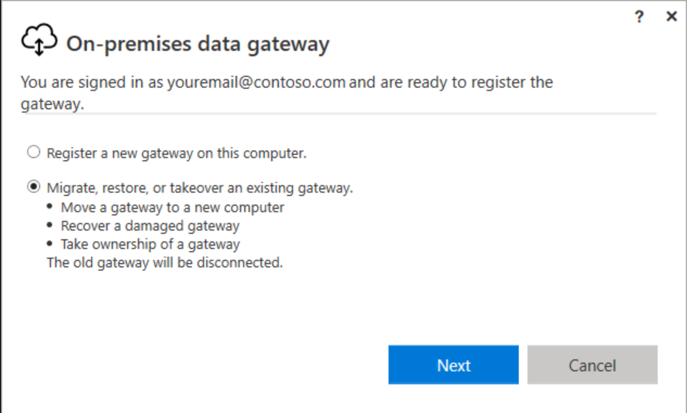
Migrate, restore, or take over a data gateway
If you're restoring the gateway on the computer that has the original gateway installation, you must first uninstall the gateway on that computer.
If you remove or delete a gateway cluster in any of the cloud services, you will not be able to restore it.
To restore or migrate:
Run the gateway installer on a computer where you want to migrate, restore, or take over an on-premises data gateway.
After you've signed-in to your Office 365 account, register the gateway. Select Migrate, restore, or takeover an existing gateway > Next.
Microsoft Confidential

Slide 32
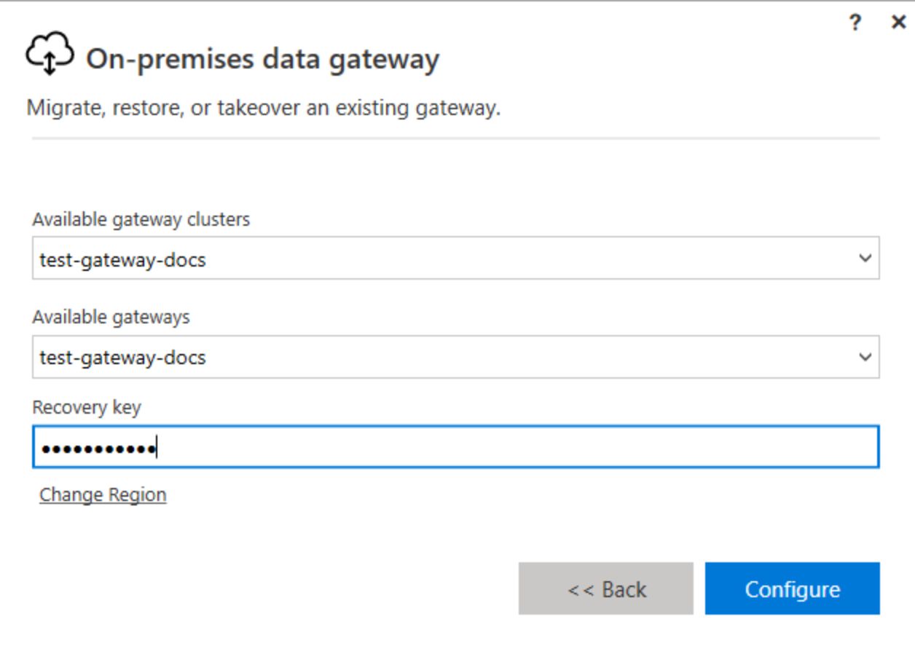
Migrate, restore, or take over a data gateway
Select from the available clusters and gateways then enter the recovery key for the selected gateway. You created and safely stored the recovery key when you originally installed the gateway -> Configure.
After the configuration finishes, the process of migrating, restoring, or taking over is complete.
Microsoft Confidential

Slide 33
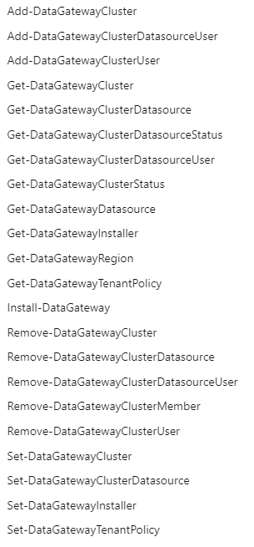
Use PowerShell to manage gateways
Two scopes are supported by cmdlets:
Individual is used to access entities that belong to the current user.
Organization is used to access entities across the entire tenant. Only Power BI service admins or the O365 global admins are allowed to use this option.
Limitations:
These PowerShell scripts may not work as expected for GCC customers and hence aren't supported in GCC.
These PowerShell scripts are also not supported for VNET gateways.
Supported in PowerShell 7.0.6 or higher
https://learn.microsoft.com/en-us/powershell/gateway/overview?view=datagateway-ps
Microsoft Confidential

Slide 34
Questions?

Slide 35
Lab 1 and 2
Lab Description
Lab 1. Install an on-premises data gateway Lab 2. Build an app using On-premise data gateway
Notes:
Link to lab: https://labondemand.com/LabProfile/
##########

Slide 36
Microsoft

